Slide 1
Measuring quickness of footballers
Quickness in football is quite tricky to define. Can mean a lot of things and most often is context-based. In this work, a few different directions have been worked on and a few more are suggested.
Very coarse level and simplistic – top speed, top acceleration and median sprint speed (when running > 7 m/s)
Grainier – look at sprint speeds in different contexts. Long distance running is not that frequent in football. Short distance/ short burst of sprints are more common.
Median sprint speed when sustaining sprint for greater than 1 second
Median sprint speed when sustaining sprint for 10 to 20 meters
Median sprint speed when sustaining sprint for 20 to 30 meters
Median sprint speed when sustaining sprint for 30 to 40 meters
Median sprint speed when sustaining sprint for greater than 40 meters
Context-based – different kinds of situations. On-ball running very different from off-ball running. Defensive phase running very different from offensive phase running.
look at top speed, top acceleration and median sprint speed when running with the ball
look at top speed, top acceleration and median sprint speed when defending
Quickness can also refer to how quickly the ball gets released by players. But this requires lots of context. Here a simple proxy is used – median ball holding duration.
External package used – “kloppy” for some pre-processing, Laurie Shaw’s FoT code
Dataset – Skill Corner open data – 9 games, 7 used (2 games threw errors with kloppy’s preprocessing)
Methodology – generate the above metrics for each game for all players. When combining, keep only the larger value for players who have played in 2 games. All metrics presented in SI units.

Slide 2
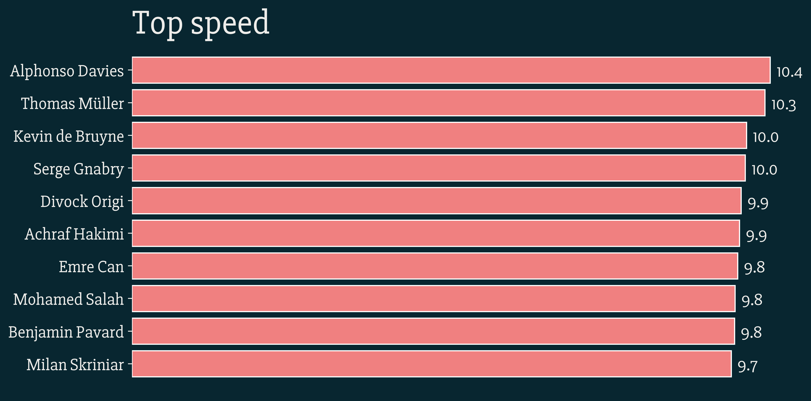
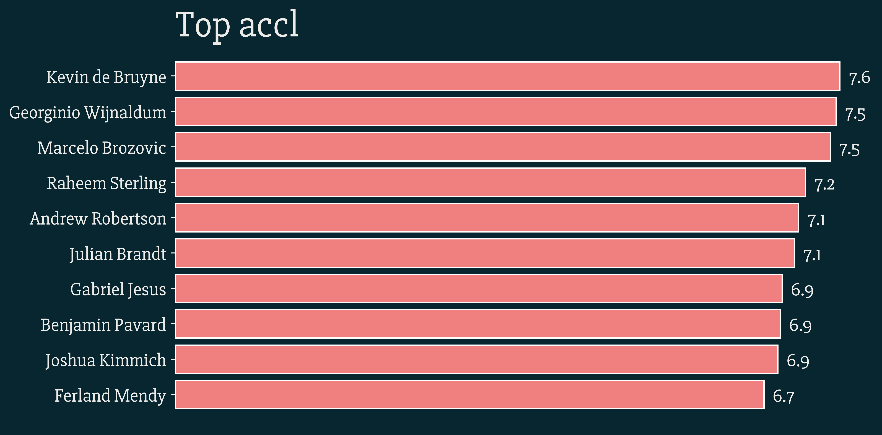
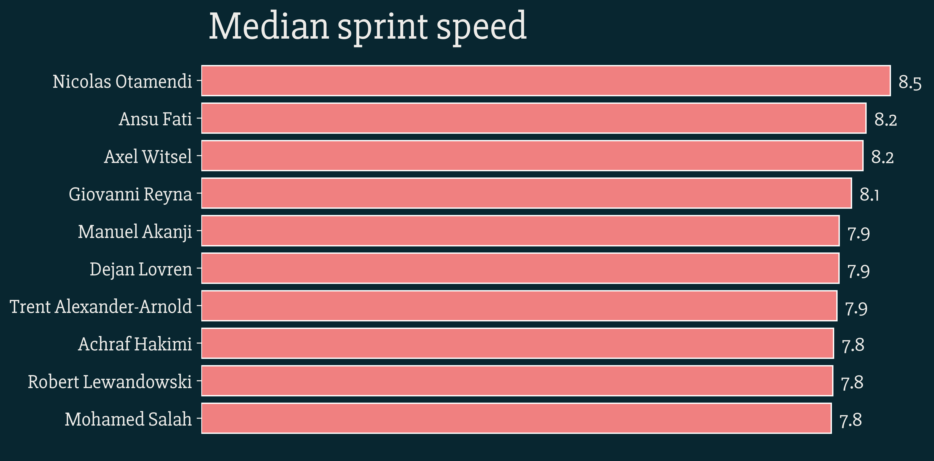
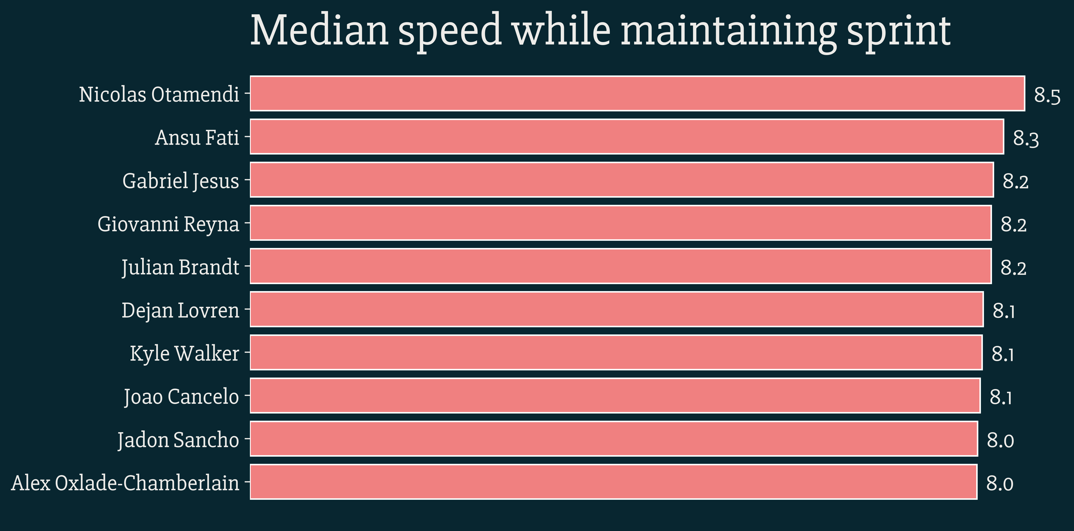
Course view of “quickness”

Slide 3
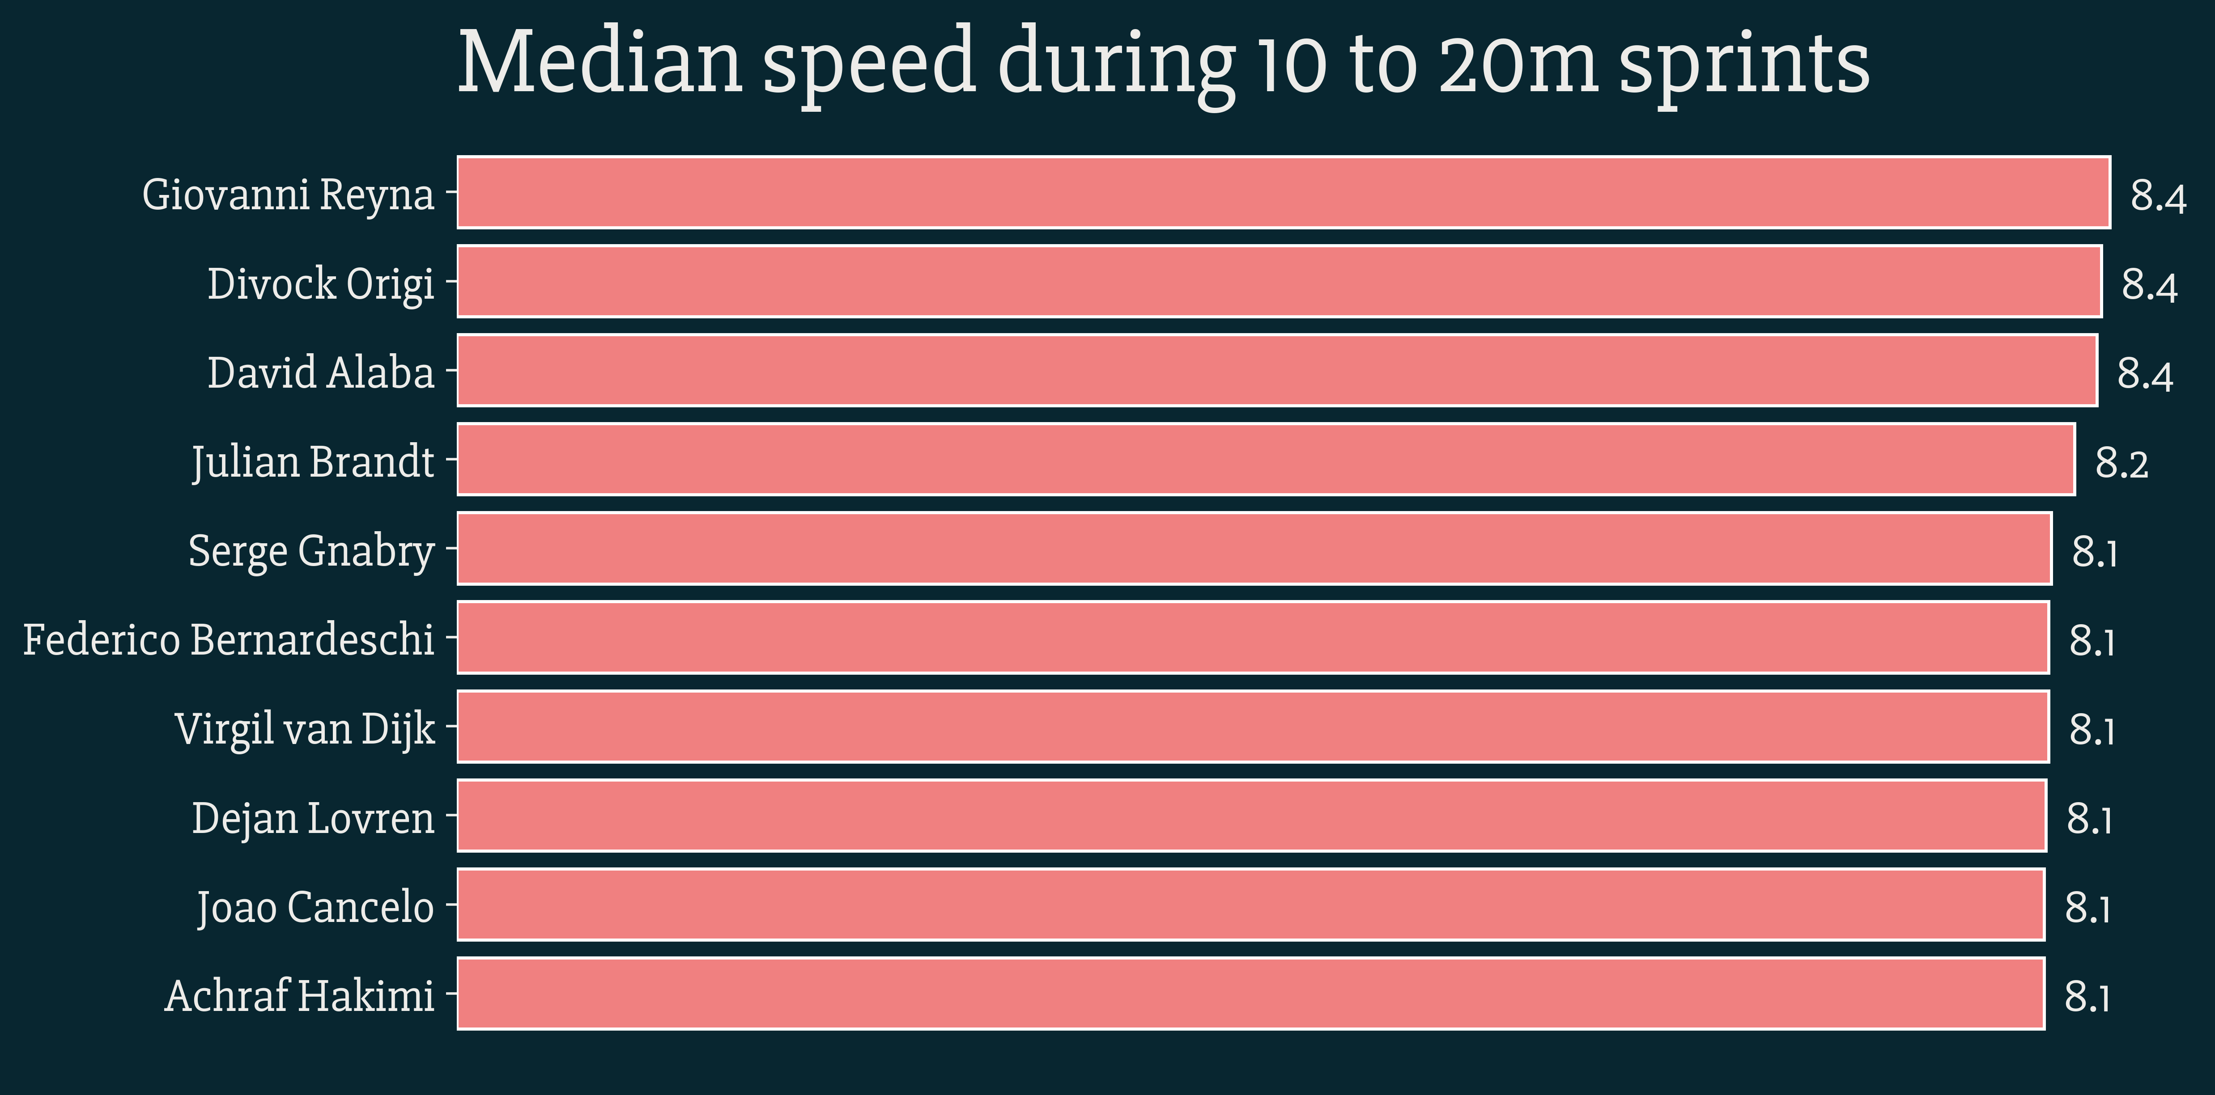
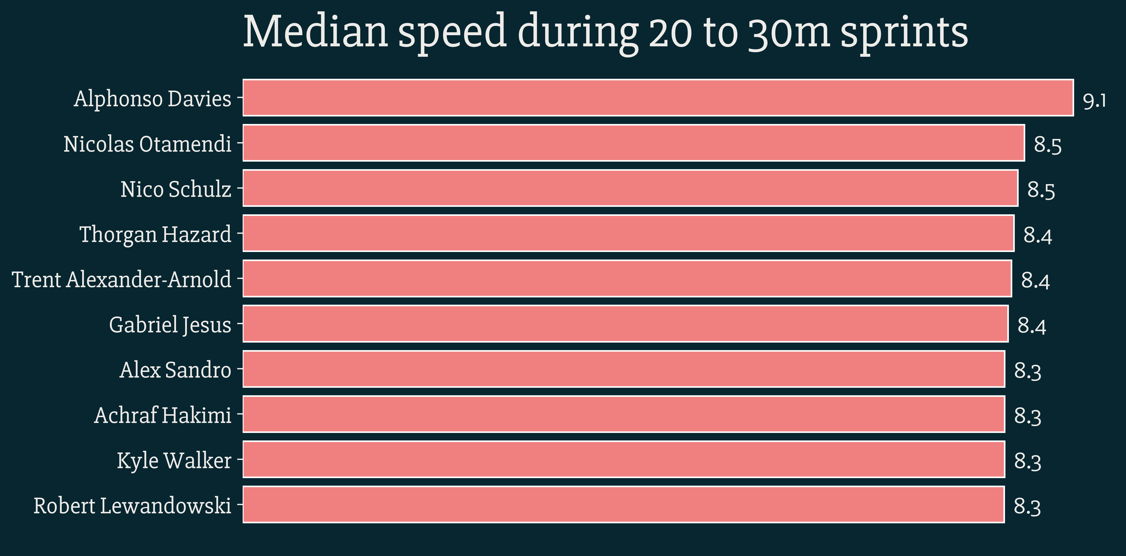
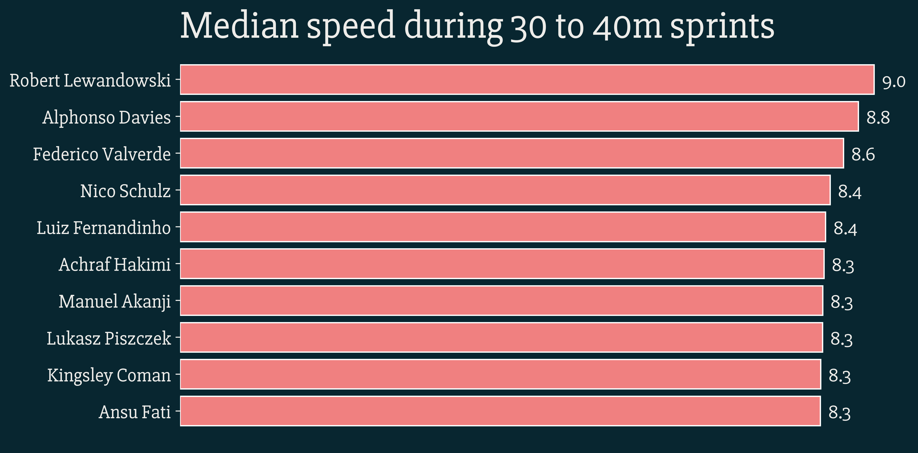
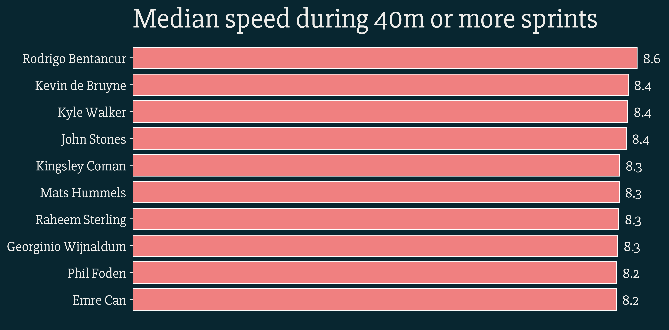
Breaking down sprints into distance bins

Slide 4
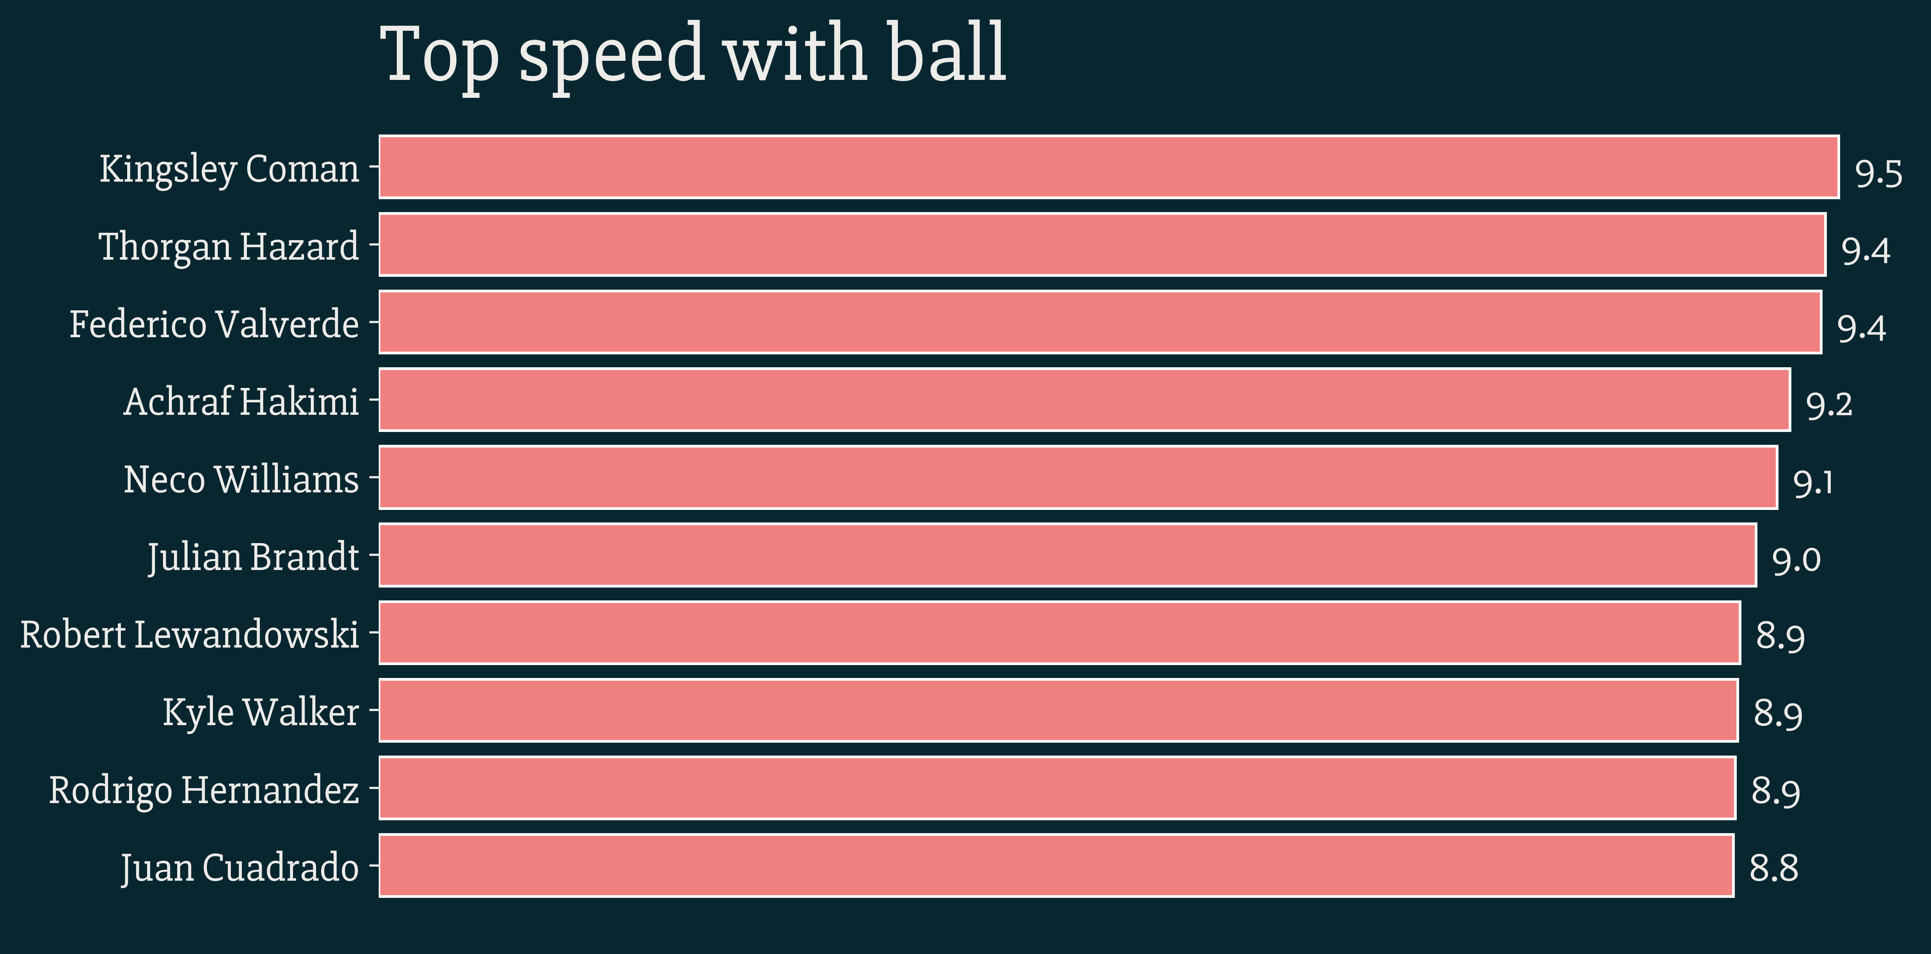
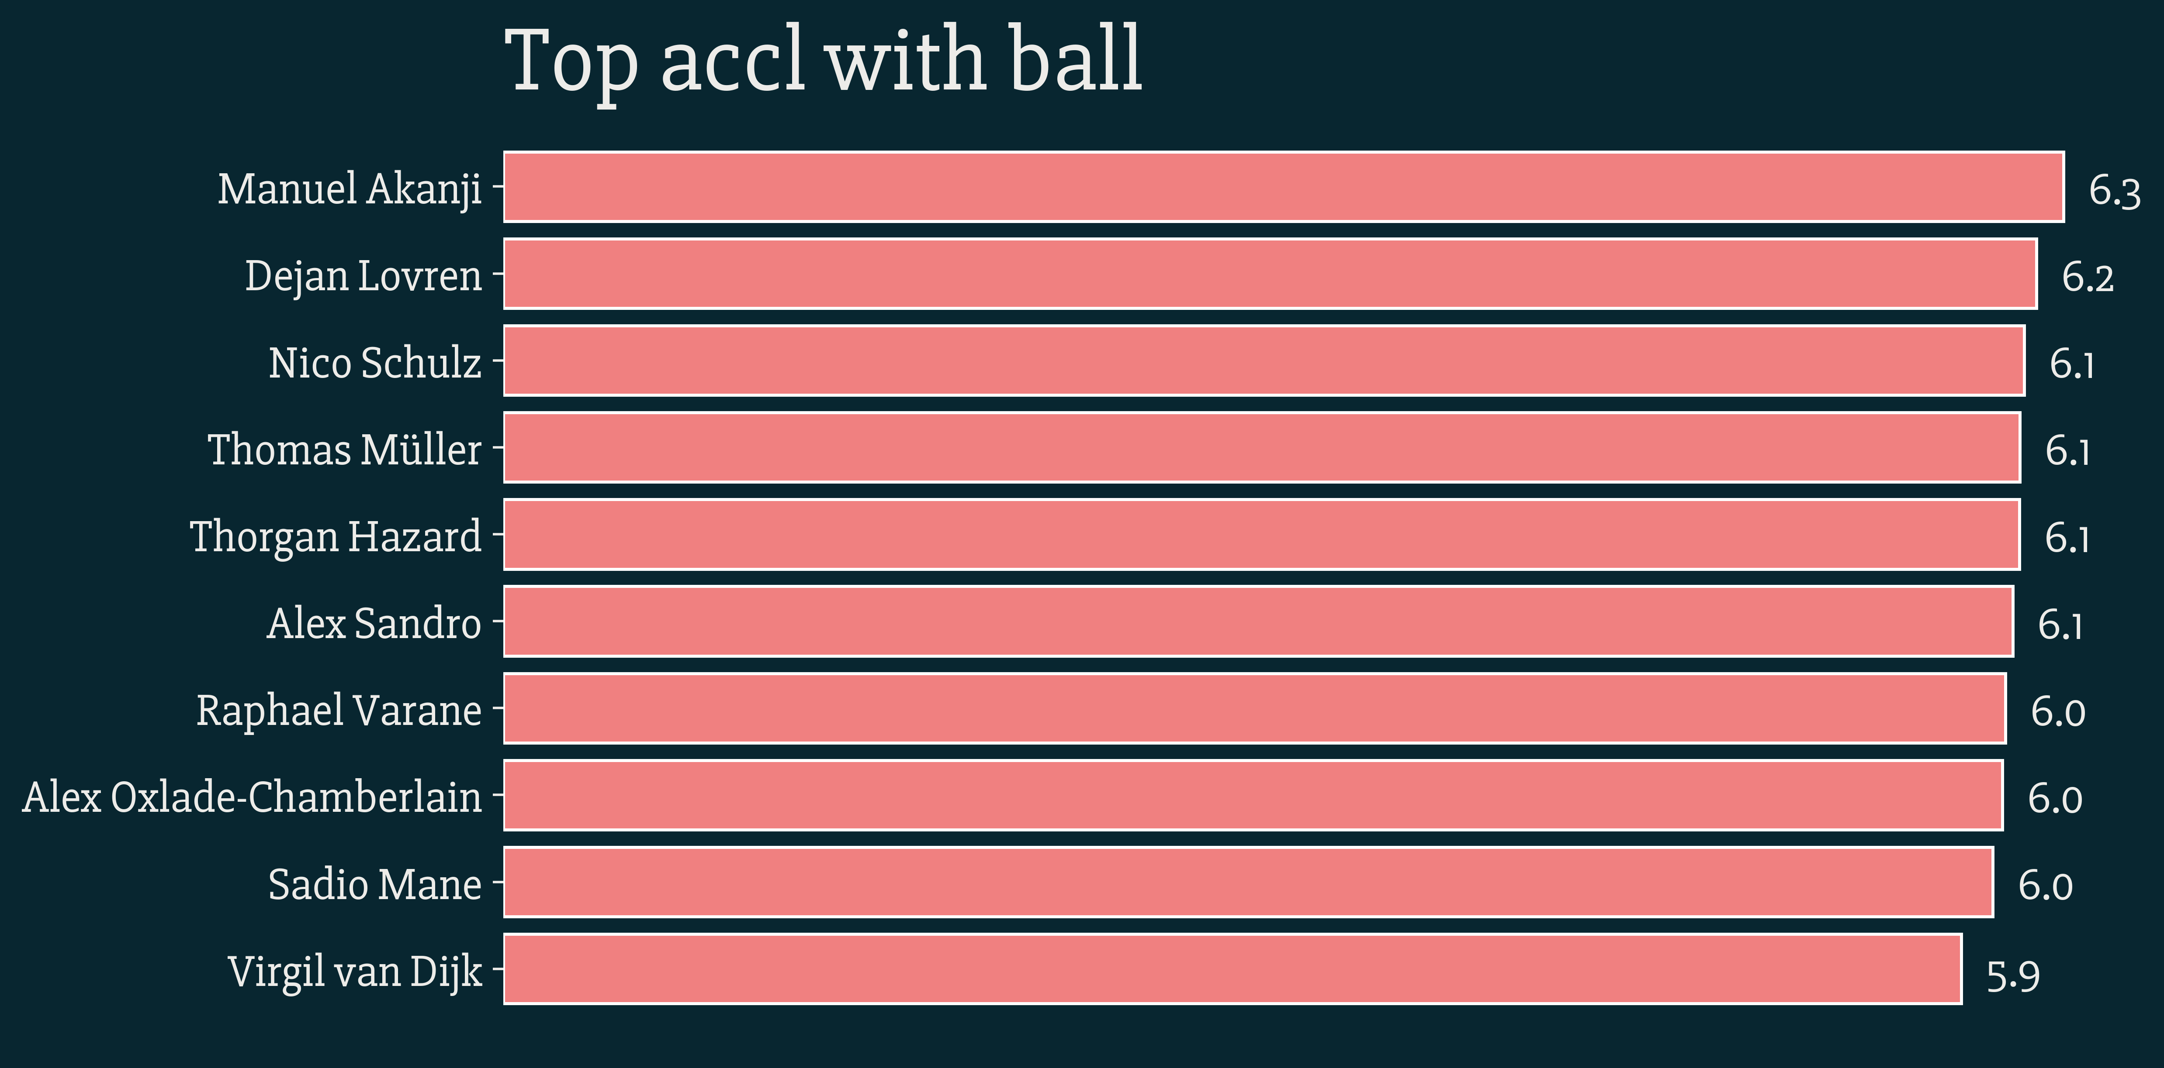
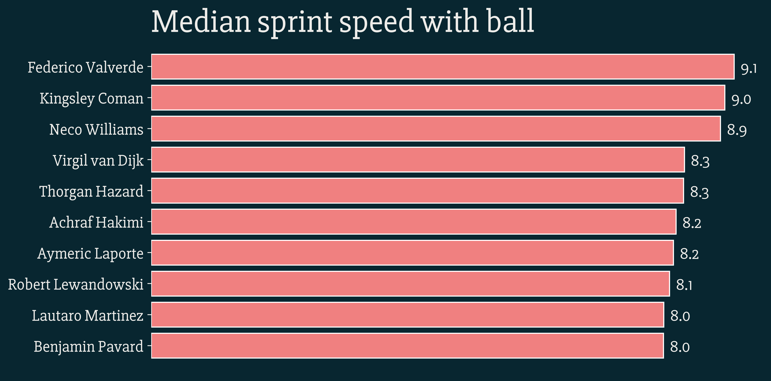
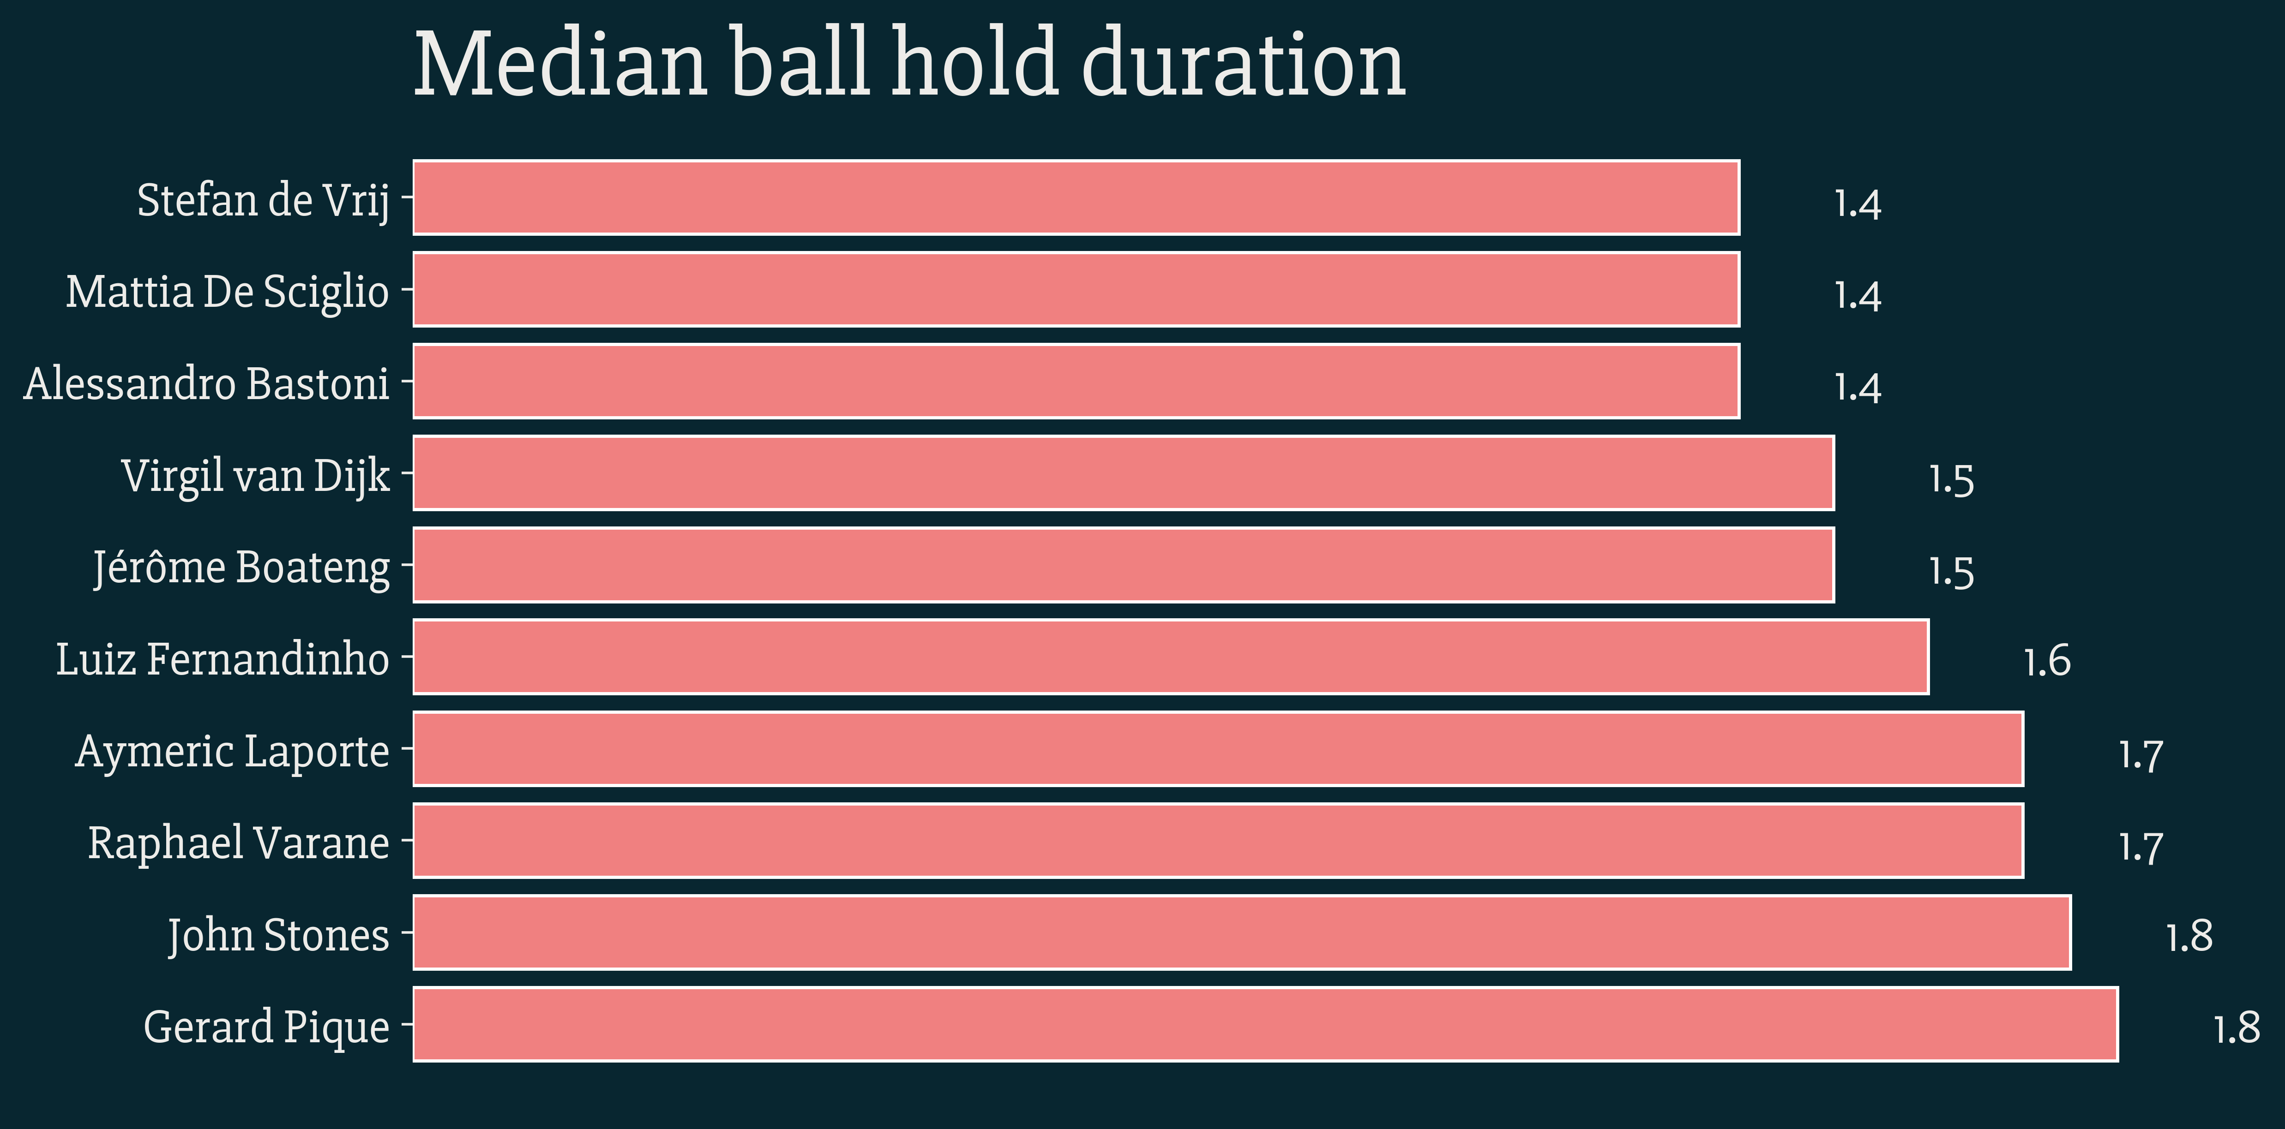
Running with the ball

Slide 5
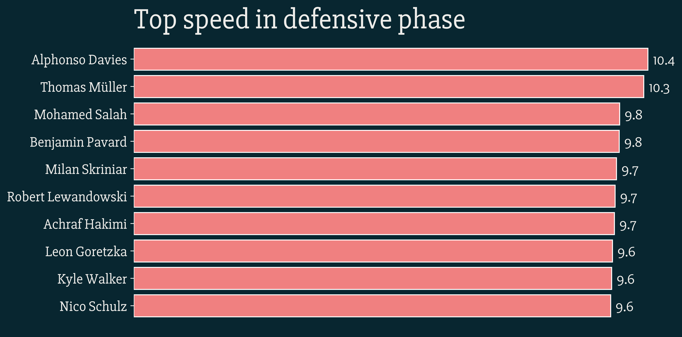
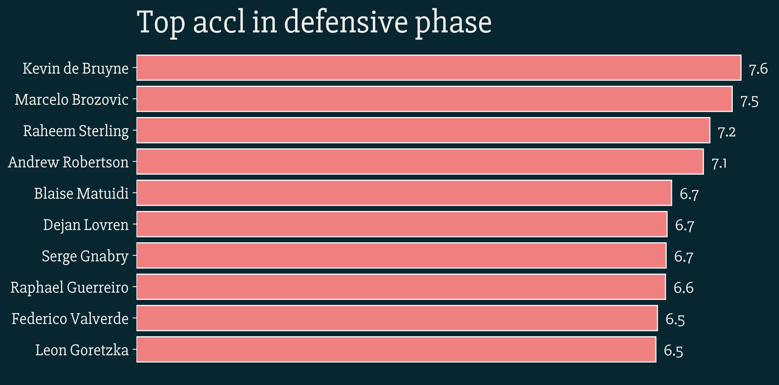
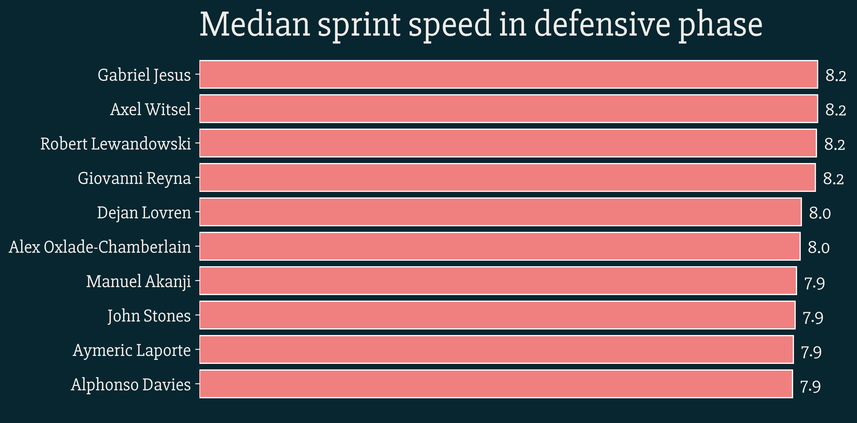
Defensive phase running

Slide 6
1. What are the pros and cons of this definition?
I didn’t use a single definition; instead tried to calculate quickness in a bunch of different ways and in different contexts. However, some of the contexts need much more detailed investigation. Also, one particular aspect of quickness – reflex and response speed – seems hard to measure from this data.
2. Describe your general approach and any difficulties you encountered
Methodology – generate the metrics for each game for all players. When combining, keep only the larger value for players who have played in 2 games. All metrics presented in SI units.
Difficulties – absence of event data makes context hard to understand. Pre-processing using kloppy failed for 2 of the games.
3. What would you do differently if you had more time? More data?
More time would have allowed me to write my own completely independent pre-processor. I did do some pre-processing of the json files separately, but not at the level of kloppy. More time would have allowed to me explore the data in a more detailed fashion and understand certain contexts like defensive tracking back better. More data would have allowed me to create a range of data instead of a single point (max of two games) and show distribution plots. More data also removes outliers and fills up (probably) missing values.
4. How would your approach differ if you had access to a controlled environment and could test players?
Certain metrics required proxies. For e.g. quickness of release. Also, reaction speed/reflex could not be evaluated at all. These can be done better in a controlled environment. Exact sprint distances can be set up (10m,20m etc), zigzag pathways sprinting, turning with and without ball, reacting to turnovers in practice games with GPS tracking data etc.

